Slide 1
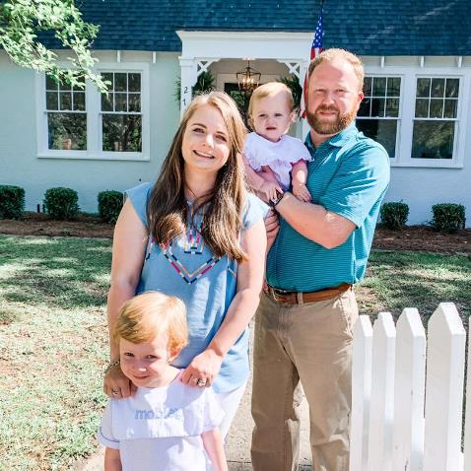
Welcome to 1st Grade!
Hi! My name is Maggie DeLoach. I am so excited to be your teacher this year. We are going to have so much fun learning with each other.

Slide 2



Mrs. DeLoach Contact Information
Email:deloama@boe.richmond.k12.ga.us
Class Dojo: This will be used as our form of communication on a daily basis. A link will be sent to you in order for you to Join. *Most of you have already joined.*
Canvas
Zoom

Slide 3
I can’t wait to meet everyone! We are scheduled to begin on September 8th!
Email me if you do not have your LaunchPad login, and I will reply with the username and password.
IF we are virtual our first Zoom meeting will be at 9am, Tuesday September 8th! I will post the link in Class DoJo ☺

Slide 4
Example of Virtual Schedule

Slide 5
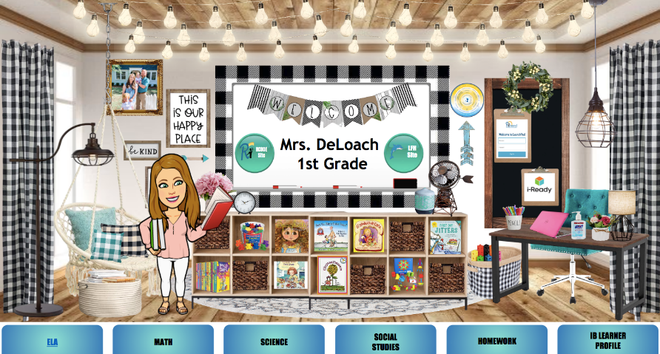
Bitmoji Classroom
(This will be on Canvas.)

Slide 6
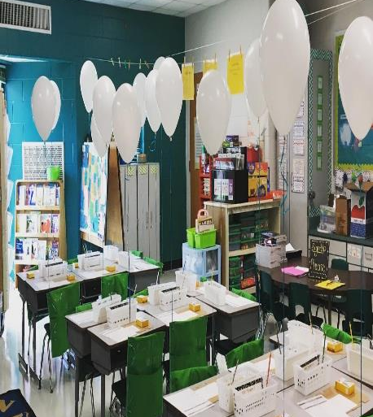
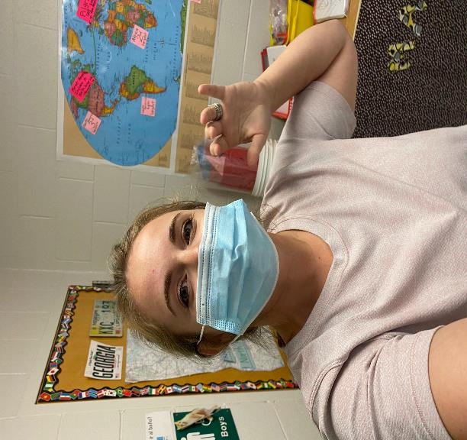
Getting Our Room Ready!

Slide 7
Homework
This is an example of our weekly homework calendar.

Slide 8
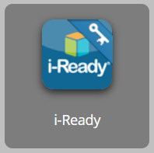
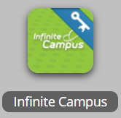
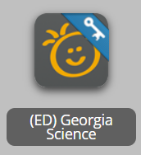

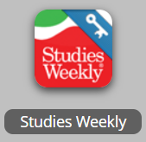
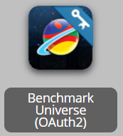
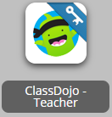
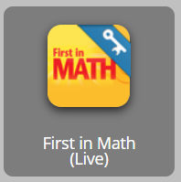
is Launch Pad?
These are some of the programs we will use this year.
Math Program
Science Program
English Language Arts Program
Social Studies Program
An app we use to communicate and make announcements.
Math Extra Practice and Enrichment

Slide 9
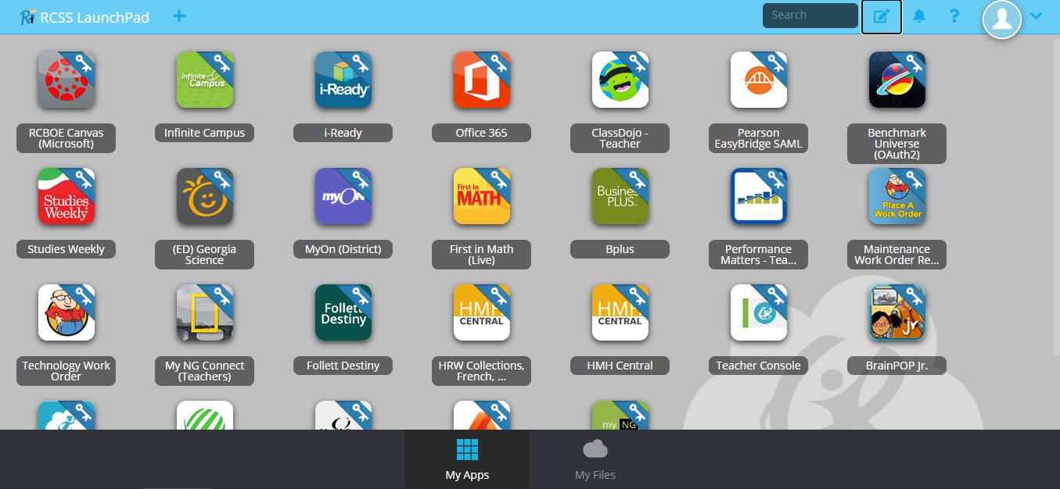
Example of LaunchPad

